Slide 1
Concurrent Quantum Separation Logic for Fine-Grained Parallelism
Yusuke Matsushita (Kyoto University)
w/ Kengo Hirata and Ryo Wakizaka
21th January, 2025 @ TPSA 2025
Notes:
Hello everyone. I am Yusuke Matsushita from Kyoto University.
I am delighted to have the opportunity to give a talk to you, here at the first TPSA.
Today, I will explain my joint work with Kengo Hirata and Ryo Wakizaka, on Concurrent Quantum Separation Logic for Fine-Grained Parallelism.

Slide 2
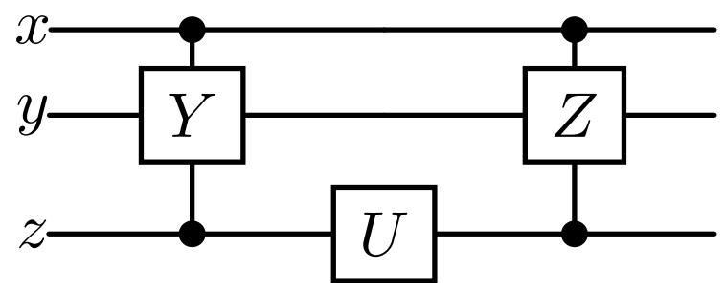
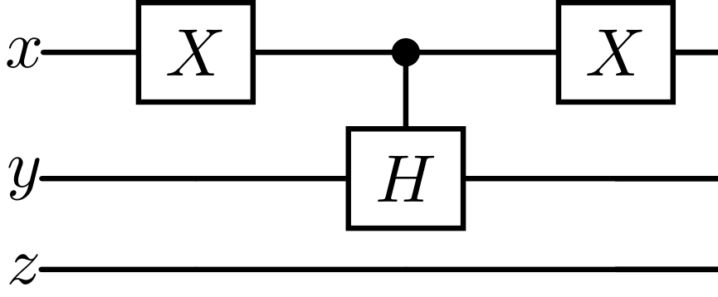
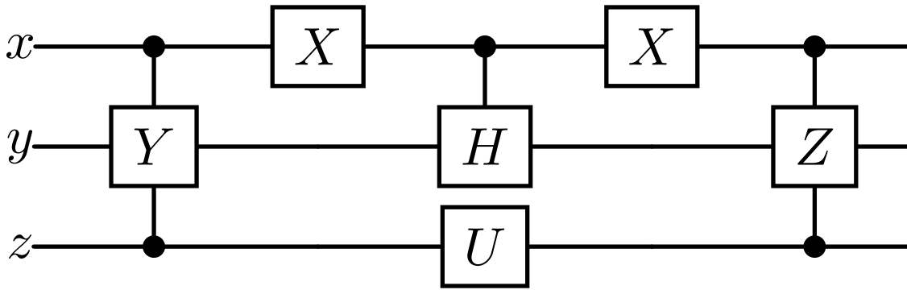



Overview of Our Work
We propose concurrent quantum separation logic for
modularly verifying quantum programs with fine-grained parallelism
Compared to existing quantum SLs [Zhou+ LICS’21] [Le+ POPL’22],
our logic is the first to support concurrency and the sharing of quantum resources, and can verify non-trivial programs
Shared variables ($x,y$)
Embedding via atomicity
$$∣∣$$
$$≡$$
Notes:
In this work, we propose concurrent quantum separation logic for modularly verifying quantum programs with fine-grained parallelism.
Compared to existing quantum separation logics, our logic is the first to support concurrency and the sharing of quantum resources, and can verify various non-trivial quantum programs.
Below, we illustrate an example of such a quantum program.
(~1min)

Slide 3
Outline
Preliminaries on Quantum Computing
Motivation: Parallelizing Quantum Programs
Our Work: Concurrent QSL for Fine-Grained Parallelism
Extension to Probabilistic Reasoning & Conclusion
Notes:
First, I start with a brief introduction to quantum computing.
Quantum things may look fancy, but please take it easy. You need not understand them 100%. Honestly, even I don’t.

Slide 4
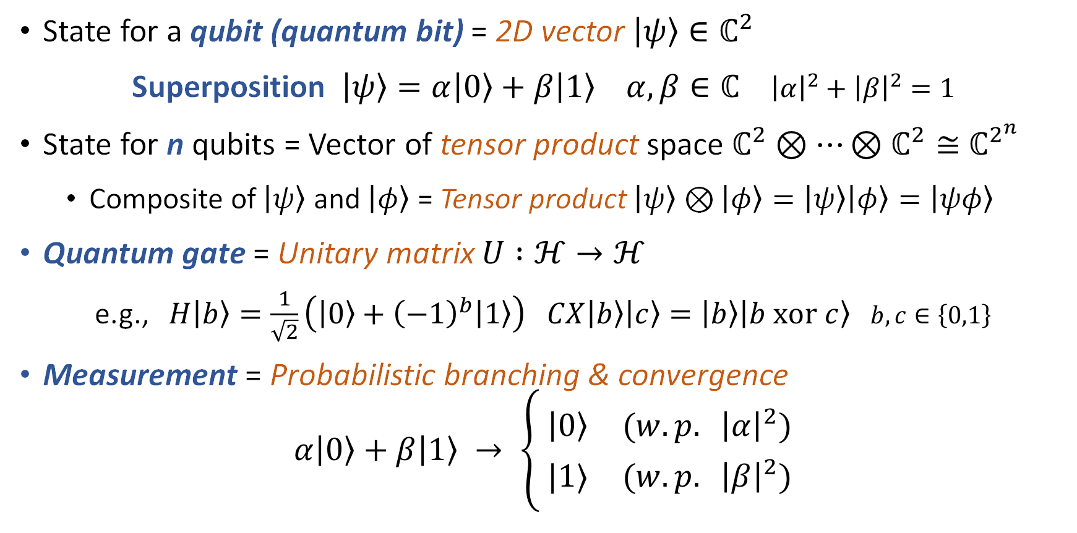
Basics of Quantum Computing
State for a qubit (quantum bit) = 2D vector $\left|ψ\right\rangle ∈ℂ^{2}$
Superposition $\left|ψ\right\rangle =α\left|0\right\rangle +β\left|1\right\rangle α,β∈ℂ$ ${\left|α\right|}^{2}+{\left|β\right|}^{2}=1$
State for n qubits = Vector of tensor product space $ℂ^{2}⊗⋯⊗ℂ^{2}≅{ ℂ}^{2^{n}}$
  Composite of $\left|ψ\right\rangle$ and $\left|φ\right\rangle$ = Tensor product $\left|ψ\right\rangle ⊗\left|φ\right\rangle =\left|ψ\right\rangle \left|φ\right\rangle =\left|ψφ\right\rangle$
Quantum gate = Unitary matrix $U :ℋ→ℋ$
e.g., $H\left|b\right\rangle =\frac{1}{\sqrt{2}}\left(\left|0\right\rangle +{\left(−1\right)}^{b}\left|1\right\rangle \right)$ $CX\left|b\right\rangle \left|c\right\rangle =\left|b\right\rangle \left|b xor c\right\rangle$ $b,c∈\left\{0,1\right\}$
Measurement = Probabilistic branching & convergence
$$α\left|0\right\rangle +β\left|1\right\rangle → \left\{\begin{aligned} \left|0\right\rangle (w.p. {\left|α\right|}^{2}) \\ |1⟩ (w.p. {\left|β\right|}^{2})\end{aligned}\right.$$
Hadamard
Controlled X
Notes:
The basic building block of quantum computing is a qubit, or a quantum bit.
While a classical bit can only be either 0 or 1, a qubit can be an arbitrary superposition of them, which is technically a linear combination.
For multiple qubits, we technically consider the tensor product, which accommodates superposition of exponentially many classical states.
Please keep in mind the notation for the tensor product, or composite state, with some shorthand.
The gates applied to qubits are restricted to unitary matrices.
For example, the Hadamard gate generates a superposition like this. Also, the controlled X gate operates on multiple qubits.
The result of quantum computing can be obtained by measurement, which lets a quantum superposition converge to a classical state with a probability determined by coefficients.

Slide 5
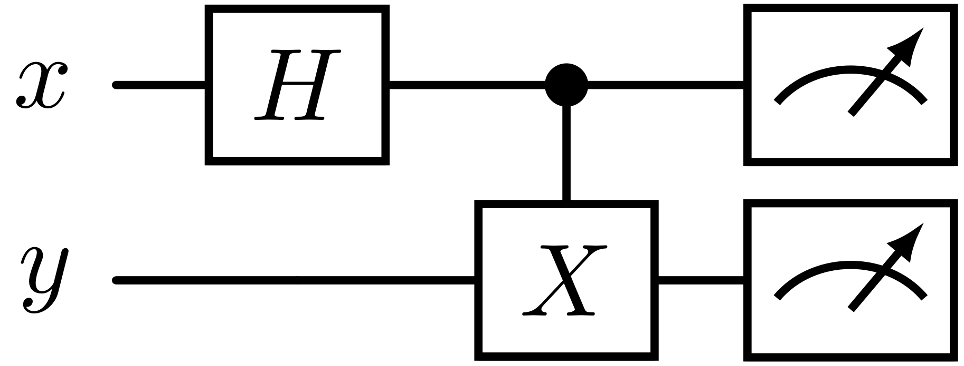

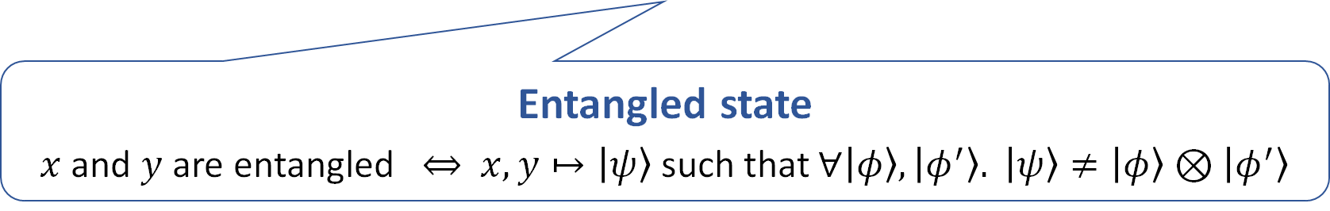

Quantum Program (Circuit)
Gate applications
Measurements
qubits
Stochastic dependence
$$x,y↦\left|00\right\rangle →\left|+\right\rangle \left|0\right\rangle →\frac{1}{\sqrt{2}}\left(\left|00\right\rangle + | 11\right\rangle )→\left\{\begin{aligned} \left|00\right\rangle (w.p. 1/2) \\ |11⟩ (w.p. 1/2)\end{aligned}\right.$$
$$\left|±\right\rangle ≝\frac{1}{\sqrt{2}}\left(\left|0\right\rangle ±\left|1\right\rangle \right)$$
Entangled state
$x$ and $y$ are entangled $⇔$ $x,y↦\left|ψ\right\rangle$ such that $∀\left|φ\right\rangle ,\left|φ^{′}\right\rangle . \left|ψ\right\rangle ≠\left|φ\right\rangle ⊗\left|φ^{′}\right\rangle$
Notes:
Here is an example of a quantum program, or circuit.
It applies the Hadamard gate to x, followed by the X gate on y controlled by x, and finally measures both qubits.
Starting with 00, after applying the two gates, we get a superposition of 00 and 11. By measuring it, we probabilistically get either 00 or 11, which makes the outputs of x and y stochastically dependent.
This is a typical example of an interesting phenomenon called quantum entanglement. Mathematically, an entangled state cannot be simply expressed as a tensor product.
(~2min)

Slide 6
Outline
Preliminaries on Quantum Computing
Motivation: Parallelizing Quantum Programs
Our Work: Concurrent QSL for Fine-Grained Parallelism
Extension to Probabilistic Reasoning & Conclusion
Notes:
Now we are ready to discuss the motivation of our work.

Slide 7



Parallelizing Quantum Programs
Parallelizing quantum programs can reduce execution costs
  Other candidates
$$||$$
Clever scheduling
$$;$$
$$;$$
Notes:
Our work addresses parallelization of quantum programs.
As is the case with classical computing, it is a promising way to reduce execution costs.
We illustrated an example of parallelizing two circuits, with the latter made atomic. A clever scheduler can produce the efficient circuit shown on the right-hand side.
→ But the scheduler is also free to execute the two sequentially in either order.

Slide 8
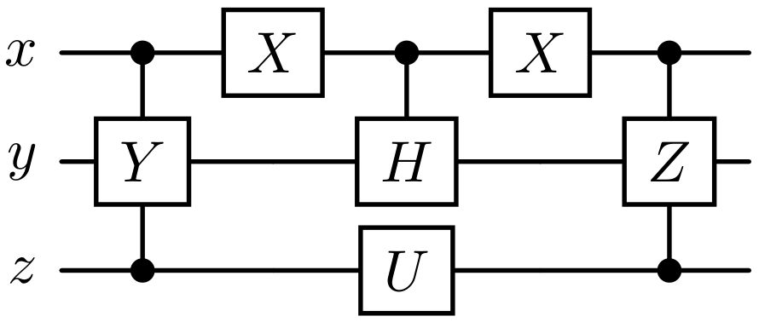
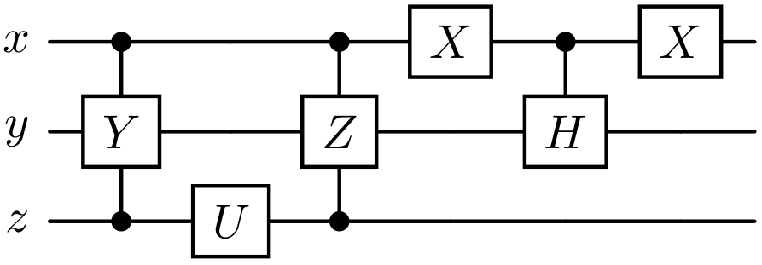
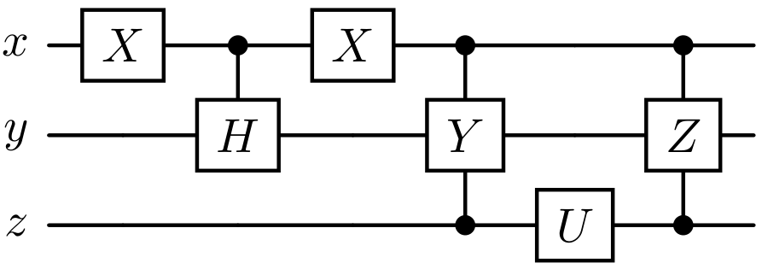



Correctness of Parallelization
Parallelization allows exponentially many execution traces!
Need a modular program logic for parallel quantum programs
  Correctness of a parallel program ≈ Uniqueness of the output
$$||$$
?
?
$$=$$
$$=$$
Notes:
As observed here, parallelization allows exponentially many execution traces.
So we need a modular program logic for verifying parallel quantum programs, which is non-trivial.
Typically, the correctness of a parallel program is the uniqueness of the output.

Slide 9



Concurrent Quantum Separation Logic for
Fine-Grained Parallelism
Our Work:
Support parallel execution of quantum processes
Support shared quantum variables
  Even when there are apparent write-write races
Support atomic expressions
  For non-interfered embedding of quantum circuits
2. Shared variables ($x,y$)
3. Embedding via atomicity
1.
$$∣∣$$
$$≡$$
Notes:
To achieve this goal, we propose concurrent quantum separation logic, which has the following notable features.
First, our logic supports parallel execution of quantum processes.
Second, it supports shared quantum variables, even when there are apparent write-write races.
Third, our logic supports atomic expressions, for non-interfered embedding of quantum circuits in parallelization.
(~1min30)

Slide 10
Outline
Preliminaries on Quantum Computing
Motivation: Parallelizing Quantum Programs
Our Work: Concurrent QSL for Fine-Grained Parallelism
Extension to Probabilistic Reasoning & Conclusion
Notes:
From now on, I will explain our work in more detail.

Slide 11
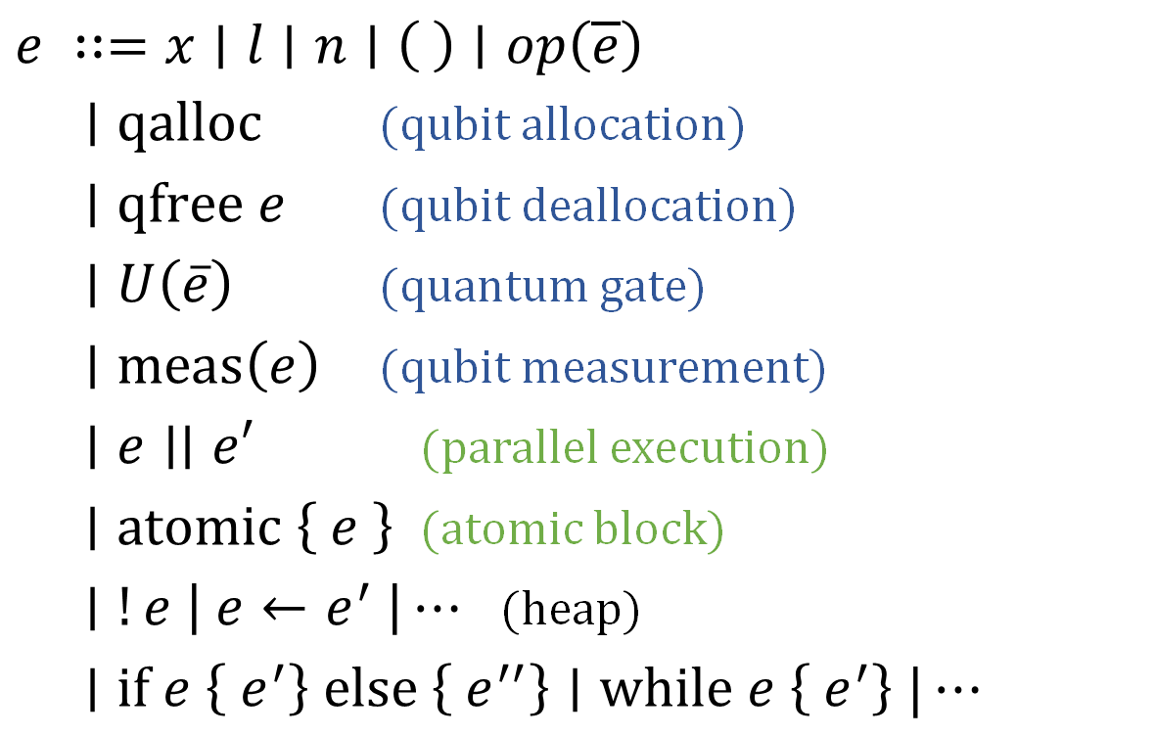
Our Target Language
$e ∷=x∣l∣n∣\left( \right)∣op\left(\overline{e}\right)$
$∣qalloc$ (qubit allocation)
$∣qfree e$ (qubit deallocation)
$∣U\left(\overline{e}\right)$ (quantum gate)
$∣meas\left(e\right)$ (qubit measurement)
$∣e∣∣e′$ (parallel execution)
$∣atomic \left\{ e \right\}$ (atomic block)
$∣!e \left| e←e^{′} \right|⋯$ (heap)
$∣if e \left\{ e^{′}\right\} else \left\{ e^{′′}\right\}∣while e \left\{ e^{′}\right\} |⋯$
Quantum
Concurrency
Notes:
Our target language looks like this.
It has primitives for quantum operations, parallel execution and an atomic block for concurrency, and classical heap operations and control flows.

Slide 12
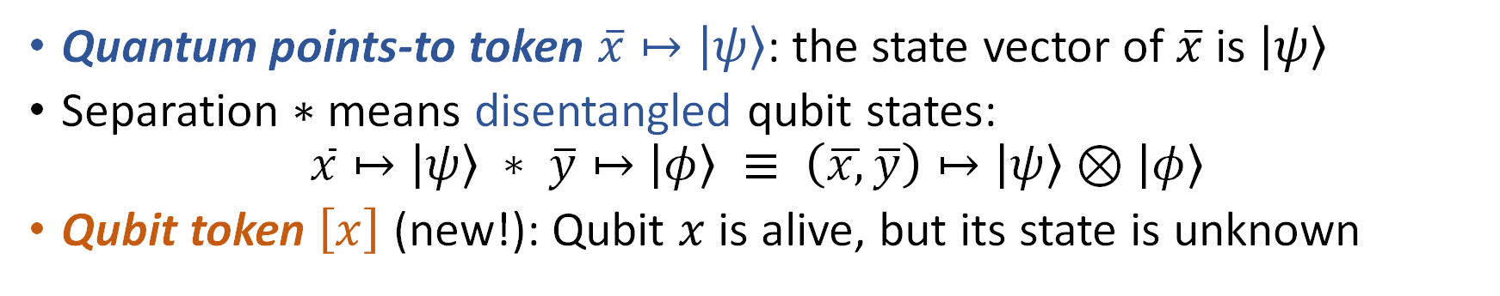
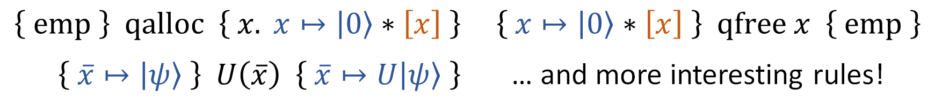


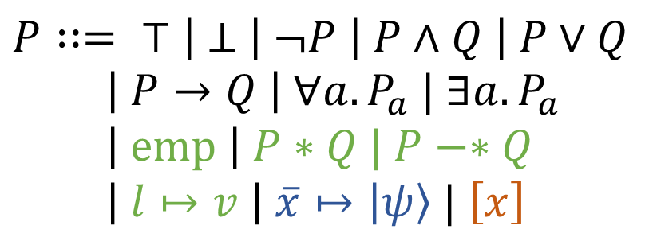
Overview of Our Logic
Invariant
$$P∷= ⊤ \left| ⊥ \right| ¬P \left| P∧Q \right| P∨Q$$
$\left| P→Q \right| ∀a. P_{a} | ∃a. P_{a}$
$\left| emp \right| P∗Q | P−∗Q$
$\left| l↦v \right| \overline{x}↦\left|ψ\right\rangle | \left[x\right]$
$$\left\{P\right\} e {\left\{v. Q\right\}}^{I}$$
$$\left\{P\right\} e \left\{v.Q\right\} ≜ \left\{P\right\} e {\left\{v.Q\right\}}^{emp}$$
(SL connectives)
$\left\{ emp \right\} qalloc \left\{ x. x↦\left|0\right\rangle ∗\left[x\right] \right\} \left\{ x↦\left|0\right\rangle ∗\left[x\right] \right\} qfree x \left\{ emp \right\}$
$\left\{ \overline{x}↦\left|ψ\right\rangle \right\} U\left(\overline{x}\right) \left\{ \overline{x}↦U\left|ψ\right\rangle \right\}$ … and more interesting rules!
Quantum points-to token $\overline{x}↦\left|ψ\right\rangle$: the state vector of$\overline{x}$ is $\left|ψ\right\rangle$
Separation $∗$means disentangled qubit states:
$\overline{x}↦\left|ψ\right\rangle ∗ \overline{y}↦\left|φ\right\rangle ≡ \left(\overline{x,}\overline{y}\right)↦\left|ψ\right\rangle ⊗\left|φ\right\rangle$
Qubit token $\left[x\right]$ (new!): Qubit $x$ is alive, but its state is unknown
Notes:
Here is an overview of our logic.
First, as concurrent separation logic, the Hoare triple is equipped with the invariant, accessible at each atomic step.
The syntax of the assertions is shown on the right-hand side.
We have standard separation logic connectives with standard proof rules.
Like the classical heap points-to token, we introduce the quantum points-to token, which owns and asserts the state vector psi of qubits x. We can freely apply a quantum gate if we update the vector of the points-to token.
Separation of points-to tokens means not only disjoint ownership but also disentangled qubit states.
We also newly introduce the qubit token, which asserts that the qubit x is alive or allocated but its state vector is unknown.
We have more interesting proof rules, which I will explain soon.

Slide 13
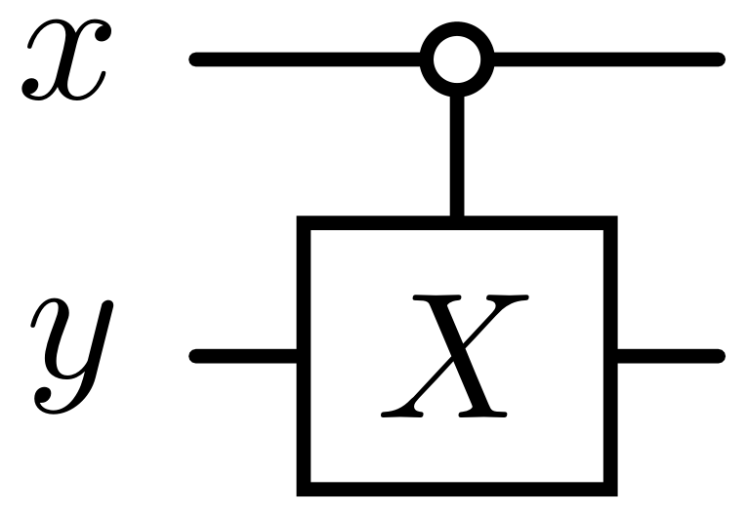
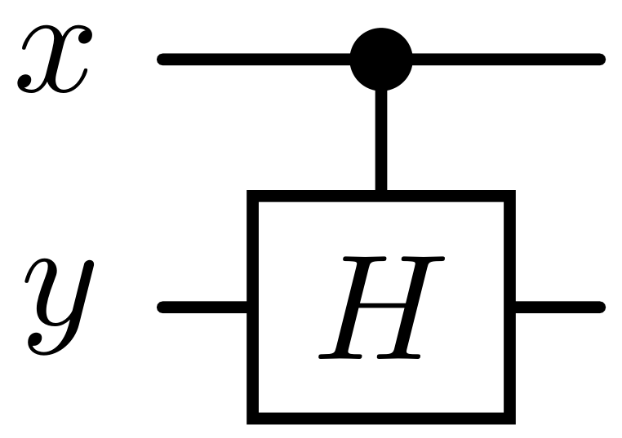
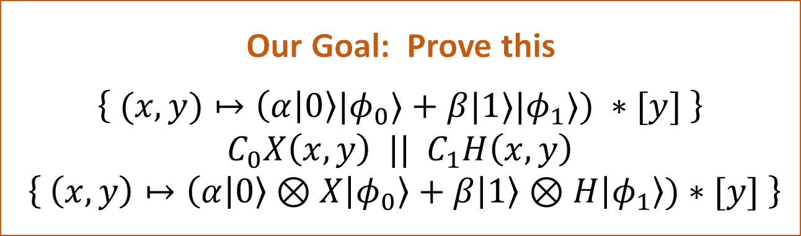



A Simple Example
$$||$$
Apparent write-write race: $X$ and $H$ gates don’t commute ($XH≠HX$)
Still, no real race condition: $C_{0}X$ and $C_{1}H$ do commute, thanks to the controls by the “cases” where x is $\left|0\right\rangle$ or $\left|1\right\rangle$resp.
$$C_{0}X\left(x,y\right) || C_{1}H\left(x,y\right)$$
Our Goal: Prove this
$\left\{ (x,y)↦\left(α | 0\right\rangle |φ_{0}⟩+β|1⟩|φ_{1}⟩) ∗[y] \right\}$
$C_{0}X\left(x,y\right) || C_{1}H\left(x,y\right)$
$\left\{ \left(x,y\right)↦\left(α | 0\right\rangle ⊗X\left|φ_{0}\right\rangle +β\left|1\right\rangle ⊗H\left|φ_{1}\right\rangle )∗[y] \right\}$
Notes:
In this talk, I will explain and demonstrate our logic with this simple running example.
It applies non-commuting gates X and Hadamard to y in parallel, which is apparently a write-write race.
Still, technically, this is no real race condition. Zero-controlled X and one-controlled Hadamard do commute, thanks to the controls by the case where x is 0 or 1, respectively.
→ Our goal for this example is to prove this Hoare assertion, which gives the output state vector precisely.

Slide 14

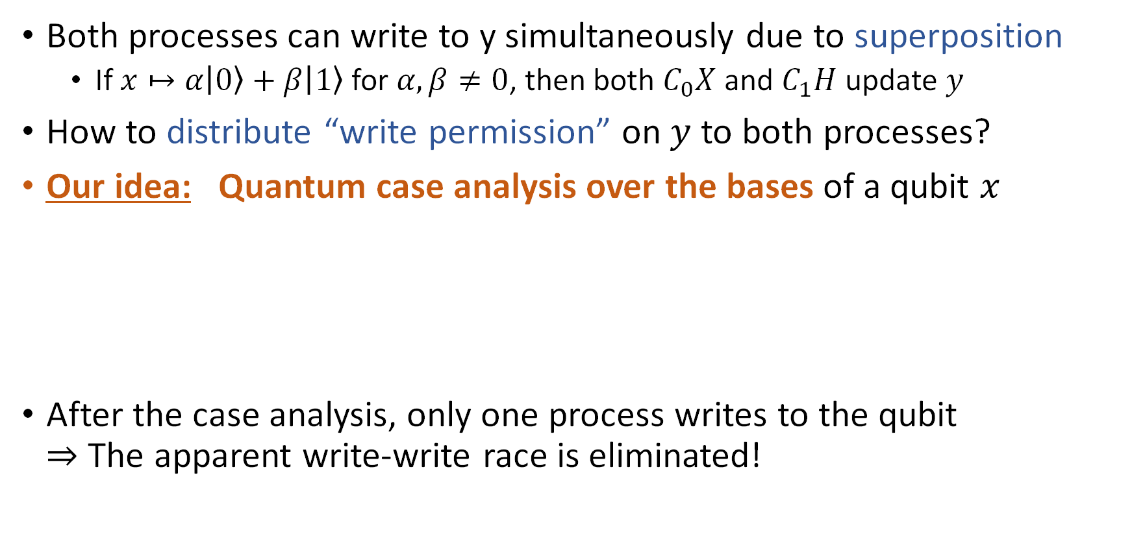




Our Key Observation
$$C_{0}X\left(x,y\right) || C_{1}H\left(x,y\right)$$
Both processes can write to y simultaneously due to superposition
  If $x↦α\left|0\right\rangle +β\left|1\right\rangle$for $α,β≠0$, then both $C_{0}X$ and $C_{1}H$ update $y$
How to distribute “write permission” on $y$ to both processes?
Our idea: Quantum case analysis over the bases of a qubit $x$
After the case analysis, only one process writes to the qubit
$⇒$ The apparent write-write race is eliminated!
$$x↦\left|0\right\rangle$$
Write permission
is not required
$$x↦\left|1\right\rangle$$
$$C_{0}X\left(x,y\right) || C_{1}H\left(x,y\right)$$
$$C_{0}X\left(x,y\right) || C_{1}H\left(x,y\right)$$
Notes:
The challenge in this example is that both processes can write to y simultaneously, because x can be a superposition of 0 and 1 in the quantum setting.
So we need to distribute the write permission on y to both processes. How can we do that in a sound way?
Our idea is to support a quantum version of a case analysis over the basis of a qubit.
In this example, we split into two worlds where the vector of x is 0 and 1, respectively.
In each simplified world, only one process writes to y. For example, if x is 0, then the one-controlled Hadamard gate does not change the state of y.
This successfully eliminates the apparent write-write race, and enables the standard separation logic reasoning.

Slide 15

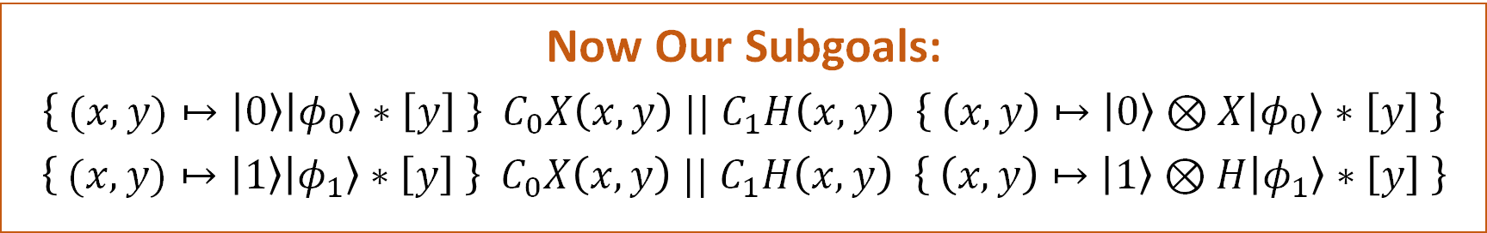
Linear Combination Rule
This idea can be formalized as linear combination of Hoare triples
  With the side condition $Q,I:precise$
    Precise assertions represent a unique (or no) resource
      e.g., $emp, ⊥,l↦v, x↦\left|ψ\right\rangle ,l↦v∗x↦\left|ψ\right\rangle$, …
    If not $I:precise$, the angelic branching on $I$ makes the rule unsound
$$\frac{\left\{ \overline{x}↦\left|ψ\right\rangle ∗P \right\} e {\left\{ \overline{x}↦\left|φ\right\rangle ∗Q \right\}}^{I} \left\{ \overline{x}↦\left|ψ′\right\rangle ∗P \right\} e {\left\{ \overline{x}↦\left|φ^{′}\right\rangle ∗Q \right\}}^{I}}{\left\{ \overline{x}↦\left(α\left|ψ\right\rangle +β\left|ψ^{′}\right\rangle \right) ∗P \right\} e {\left\{ \overline{x}↦\left(α\left|φ\right\rangle +β\left|φ^{′}\right\rangle \right) ∗Q \right\}}^{I}}$$
Now Our Subgoals:
  $\left\{ (x,y)↦\left|0\right\rangle \left|φ_{0}\right\rangle ∗\left[y\right] \right\} C_{0}X\left(x,y\right) || C_{1}H\left(x,y\right) \left\{ \left(x,y\right)↦\left|0\right\rangle ⊗X\left|φ_{0}\right\rangle ∗\left[y\right] \right\}$
  $\left\{ (x,y)↦\left|1\right\rangle \left|φ_{1}\right\rangle ∗\left[y\right] \right\} C_{0}X\left(x,y\right) || C_{1}H\left(x,y\right) \left\{ \left(x,y\right)↦\left|1\right\rangle ⊗H\left|φ_{1}\right\rangle ∗\left[y\right] \right\}$
Notes:
This idea can be formalized as the following rule for taking the linear combination of Hoare triples.
It decomposes the target state vector in some basis psi and psi prime, and then combines the outputs respecting the coefficients.
Technically, we have the side condition that Q and I are precise, or represent a unique or no resource.
Now using this rule, our goal boils down to the two subgoals shown below.

Slide 16

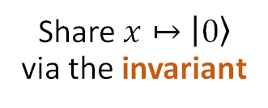

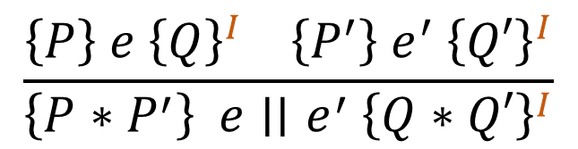
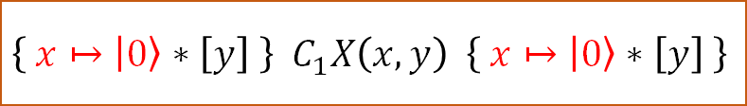
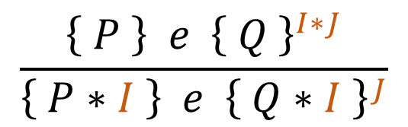
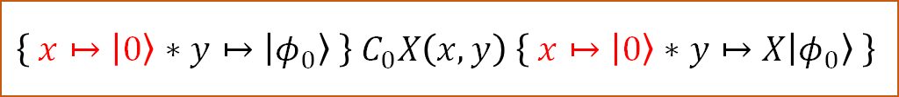
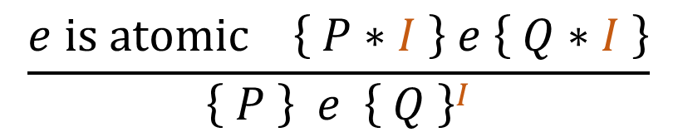
Resource Sharing via Invariants
$$\left\{ (x,y)↦\left|0\right\rangle \left|φ_{0}\right\rangle ∗\left[y\right] \right\} C_{0}X\left(x,y\right) || C_{1}H\left(x,y\right) \left\{ (x,y)↦\left|0\right\rangle ⊗X\left|φ_{0}\right\rangle ∗\left[y\right] \right\}$$
$$\left\{ y↦\left|φ_{0}\right\rangle ∗\left[y\right] \right\} C_{0}X\left(x,y\right) || C_{1}H\left(x,y\right) { \left\{ y↦X\left|φ_{0}\right\rangle ∗\left[y\right] \right\}}^{ x↦\left|0\right\rangle }$$
Share $x↦\left|0\right\rangle$
via the invariant
$$\left\{ y↦\left|φ_{0}\right\rangle \right\} C_{0}X\left(x,y\right) {\left\{ y↦X\left|φ_{0}\right\rangle \right\}}^{ x↦\left|0\right\rangle }$$
$$\left\{ \left[y\right] \right\} C_{1}X\left(x,y\right) {\left\{ \left[y\right] \right\}}^{ x↦\left|0\right\rangle }$$
$$\left\{ x↦\left|0\right\rangle ∗y↦\left|φ_{0}\right\rangle \right\} C_{0}X\left(x,y\right) \left\{ x↦\left|0\right\rangle ∗y↦X\left|φ_{0}\right\rangle \right\}$$
$$\left\{ x↦\left|0\right\rangle ∗\left[y\right] \right\} { C}_{1}X\left(x,y\right) \left\{ x↦\left|0\right\rangle ∗\left[y\right] \right\}$$
$$\frac{e is atomic \left\{ P∗I \right\} e \left\{ Q∗I \right\}}{\left\{ P \right\} e {\left\{ Q \right\}}^{I}}$$
$$\frac{\left\{ P \right\} e {\left\{ Q \right\}}^{I∗J}}{\left\{ P∗I \right\} e {\left\{ Q∗I \right\}}^{J}}$$
$$\frac{\left\{P\right\} e {\left\{Q\right\}}^{I} \left\{P^{′}\right\} e^{′} {\left\{Q′\right\}}^{I}}{\left\{P∗P^{′}\right\} e∣∣e^{′} {\left\{Q∗Q′\right\}}^{I}}$$
Notes:
We can prove the subgoals by resource sharing via invariants, a standard technique in concurrent separation logic.
Here we show how the first subgoal is proved. The second one is proved in the same way.
→ We want to reduce this subgoal to the two Hoare assertions shown at the bottom.
→ For that, we can simply move the points-to token of x into the invariant, which can be accessed by all processes at every atomic step.
The proof rules for invariants are shown below.
Now our proof is almost done. The Hoare assertion on the left-hand side can be proved easily.
→ But how can we prove the Hoare assertion on the right-hand side?

Slide 17
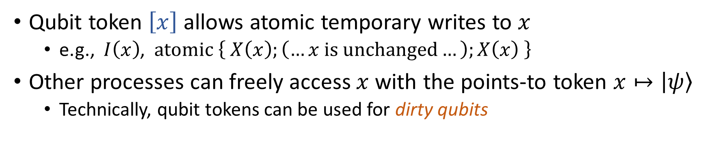
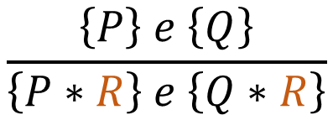

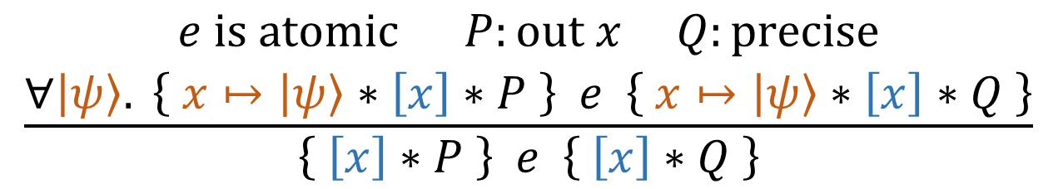
Anti-Frame Rule by Atomicity
$$\left\{ x↦\left|0\right\rangle ∗\left[y\right] \right\} C_{1}X\left(x,y\right) \left\{ x↦\left|0\right\rangle ∗\left[y\right] \right\}$$
$$\frac{\begin{aligned}e is atomic P:out x Q:precise \\ ∀\left|ψ\right\rangle . \left\{ x↦\left|ψ\right\rangle ∗\left[x\right]∗P \right\} e \left\{ x↦\left|ψ\right\rangle ∗\left[x\right]∗Q \right\}\end{aligned}}{\left\{ \left[x\right]∗P \right\} e \left\{ \left[x\right]∗Q \right\}}$$
Cf. Frame rule
$$\frac{\left\{P\right\} e \left\{Q\right\}}{\left\{P∗R\right\} e \left\{Q∗R\right\}}$$
Qubit token $\left[x\right]$ allows atomic temporary writes to $x$
  e.g., $I\left(x\right)$, $atomic \left\{ X\left(x\right);\left(…x is unchanged…\right);X\left(x\right) \right\}$
Other processes can freely access $x$with the points-to token $x↦\left|ψ\right\rangle$
  Technically, qubit tokens can be used for dirty qubits
Notes:
To solve such situations, we introduce the following novel proof rule for the qubit token.
By this rule, we can get access to the points-to token for the qubit at each atomic step.
We call this the anti-frame rule by atomicity for the qubit token, because it adds a frame to the hypothesis, instead of removing it.
This rule allows atomic writes to the qubit that is temporary, or restores the qubit state after the execution is finished, which does not interfere with other processes freely accessing the qubit.
In our example, the one-controlled X gate does not update y when x is 0, so we can use this rule to complete the whole proof.
(For PLanQC 2025) In this sense, our logic can express dirty qubits via qubit tokens.

Slide 18



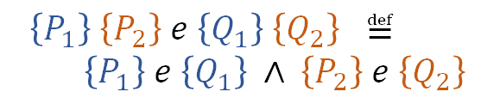
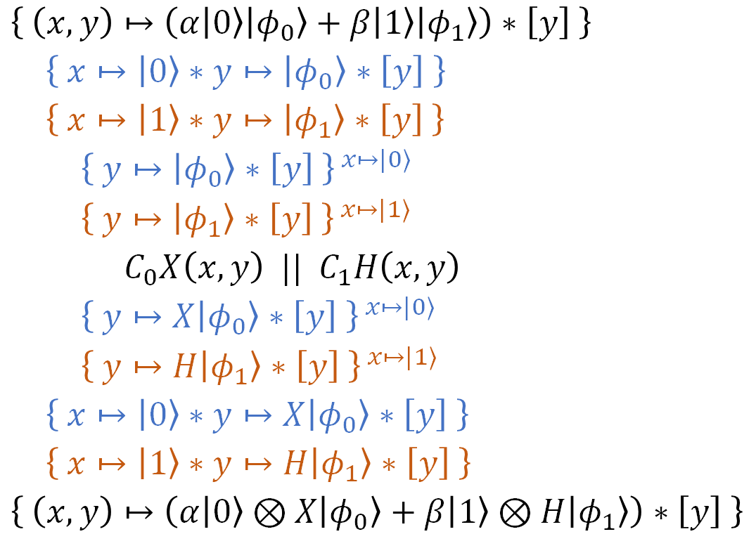
Complete Proof for $C_{0}X\left(x,y\right) ||$ $C_{1}H\left(x,y\right)$
$\left\{ \left(x,y\right)↦\left(α\left|0\right\rangle \left|φ_{0}\right\rangle +β\left|1\right\rangle \left|φ_{1}\right\rangle \right)∗\left[y\right] \right\}$
$\left\{ x↦\left|0\right\rangle ∗y↦\left|φ_{0}\right\rangle ∗\left[y\right] \right\}$
$\left\{ x↦\left|1\right\rangle ∗y↦\left|φ_{1}\right\rangle ∗\left[y\right] \right\}$
${\left\{ y↦\left|φ_{0}\right\rangle ∗\left[y\right] \right\}}^{ x↦|0⟩}$
${\left\{ y↦\left|φ_{1}\right\rangle ∗\left[y\right] \right\}}^{ x↦|1⟩}$
$C_{0}X\left(x,y\right) || C_{1}H\left(x,y\right)$
${\left\{ y↦X\left|φ_{0}\right\rangle ∗\left[y\right] \right\}}^{ x↦|0⟩}$
${\left\{ y↦H\left|φ_{1}\right\rangle ∗\left[y\right] \right\}}^{ x↦|1⟩}$
$\left\{ x↦\left|0\right\rangle ∗y↦X\left|φ_{0}\right\rangle ∗\left[y\right] \right\}$
$\left\{ x↦\left|1\right\rangle ∗y↦H\left|φ_{1}\right\rangle ∗\left[y\right] \right\}$
$\left\{ \left(x,y\right)↦\left(α\left|0\right\rangle ⊗X\left|φ_{0}\right\rangle +β\left|1\right\rangle ⊗H\left|φ_{1}\right\rangle \right)∗\left[y\right] \right\}$
${\left\{ y↦\left|φ_{0}\right\rangle \right\}}^{ x↦\left|0\right\rangle } {\left\{ \left[y\right] \right\}}^{ x↦\left|1\right\rangle }$
$\left\{ y↦ | φ_{0}\right\rangle ∗x↦\left|0\right\rangle \} \{ \left[y\right]∗x↦\left|1\right\rangle \}$
$C_{0}X\left(x,y\right)$
$\left\{ y↦X\left|φ_{0}\right\rangle ∗x↦\left|0\right\rangle \right\} \left\{ \left[y\right]∗x↦\left|1\right\rangle \right\}$
${\left\{ y↦X\left|φ_{0}\right\rangle \right\}}^{ x↦\left|0\right\rangle } { \left\{ \left[y\right] \right\}}^{ x↦\left|1\right\rangle }$
${\left\{ \left[y\right] \right\}}^{ x↦\left|0\right\rangle } {\left\{ y↦\left|φ_{1}\right\rangle \right\}}^{ x↦\left|1\right\rangle }$
$\left\{ \left[y\right] \right\} \left\{ y↦\left|φ_{1}\right\rangle ∗x↦\left|1\right\rangle \right\}$
$C_{1}H\left(x,y\right)$
$\left\{ \left[y\right]∗x↦\left|0\right\rangle \right\} \left\{ y↦H\left|φ_{1}\right\rangle ∗x↦\left|1\right\rangle \right\}$
${\left\{ \left[y\right] \right\}}^{ x↦\left|0\right\rangle } {\left\{ y↦H\left|φ_{1}\right\rangle \right\}}^{ x↦\left|1\right\rangle }$
$\left\{P_{1}\right\} \left\{P_{2}\right\} e \left\{Q_{1}\right\} \left\{Q_{2}\right\} ≝$
$\left\{P_{1}\right\} e \left\{Q_{1}\right\} ∧ \left\{P_{2}\right\} e \left\{Q_{2}\right\}$
Notes:
As a summary, we illustrate the complete proof of the Hoare assertion for the simple example.

Slide 19

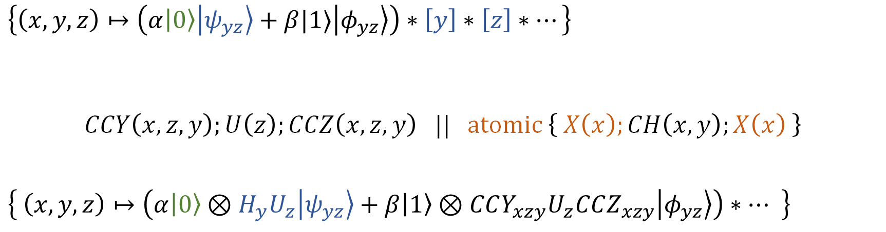





More Complex Example
$$∣∣$$
$$≡$$
$\left\{\left(x,y,z\right)↦\left(α\left|0\right\rangle \left|ψ_{yz}\right\rangle +β|1⟩\left|φ_{yz}\right\rangle \right)∗\left[y\right]∗\left[z\right]∗…\right\}$
$$CCY\left(x,z,y\right);U\left(z\right);CCZ\left(x,z,y\right) || atomic \left\{ X\left(x\right);CH\left(x,y\right);X\left(x\right) \right\}$$
$\left\{ \left(x,y,z\right)↦\left(α\left|0\right\rangle ⊗H_{y}U_{z}\left|ψ_{yz}\right\rangle +β\left|1\right\rangle ⊗CCY_{xzy}U_{z}CCZ_{xzy}\left|φ_{yz}\right\rangle \right)∗… \right\}$
Invariant
Invariant
$$x↦\left|0\right\rangle ∗\left[y\right]∗\left[z\right]$$
$$||$$
$$x↦\left|0\right\rangle ∗\left(y,z\right)↦\left|ψ_{yz}\right\rangle$$
$x$ is updated only temporarily
Notes:
Of course, our logic can support much more complex examples, including one we showed when motivating parallelized quantum programs.

Slide 20

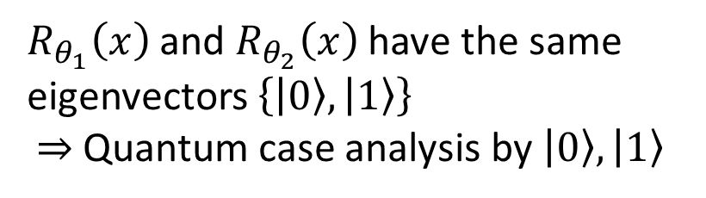
Another Fun Thing: Commuting Matrices
We can verify parallelization of arbitrary commuting matrices
  Since commutative matrices are simultaneously diagonalizable
$\left\{ x↦\left(α\left|0\right\rangle +β\left|1\right\rangle \right) \right\}$
$\left\{ x↦\left|0\right\rangle \right\}$ $\left\{ x↦\left|1\right\rangle \right\}$
${\left\{ ()↦1 \right\}}^{ x↦|0⟩} {\left\{ ()↦1 \right\}}^{ x↦|1⟩}$
$R_{θ_{1}}\left(x\right) ||$ $R_{θ_{2}}\left(x\right)$
${\left\{ ()↦1 \right\}}^{ x↦|0⟩} {\left\{ () ↦e^{i\left(θ_{1}+θ_{2}\right)} \right\}}^{ x↦|1⟩}$
$\left\{ x↦\left|0\right\rangle \right\}$ $\left\{ x↦e^{i\left(θ_{1}+θ_{2}\right)}\left|1\right\rangle \right\}$
$\left\{ x↦\left(α\left|0\right\rangle +βe^{i\left(θ_{1}+θ_{2}\right)}\left|1\right\rangle \right) \right\}$
$R_{θ_{1}}\left(x\right)$ and $R_{θ_{2}}\left(x\right)$ have the same
eigenvectors $\left\{\left|0\right\rangle ,\left|1\right\rangle \right\}$
$⇒$ Quantum case analysis by $\left|0\right\rangle ,\left|1\right\rangle$
Global phases can be tracked with
empty-qubit points-to tokens
Notes:
Interestingly, we can even verify parallelization of arbitrary commuting matrices, since commutative matrices are always simultaneously diagonalizable.
We can use the linear combination rule for that.
(-6min)

Slide 21
Outline
Preliminaries on Quantum Computing
Motivation: Parallelizing Quantum Programs
Our Work: Concurrent QSL for Fine-Grained Parallelism
Extension to Probabilistic Reasoning & Conclusion
Notes:
Great. Finally, I will discuss our ongoing extension to probabilistic reasoning, which is interesting on its own.

Slide 22
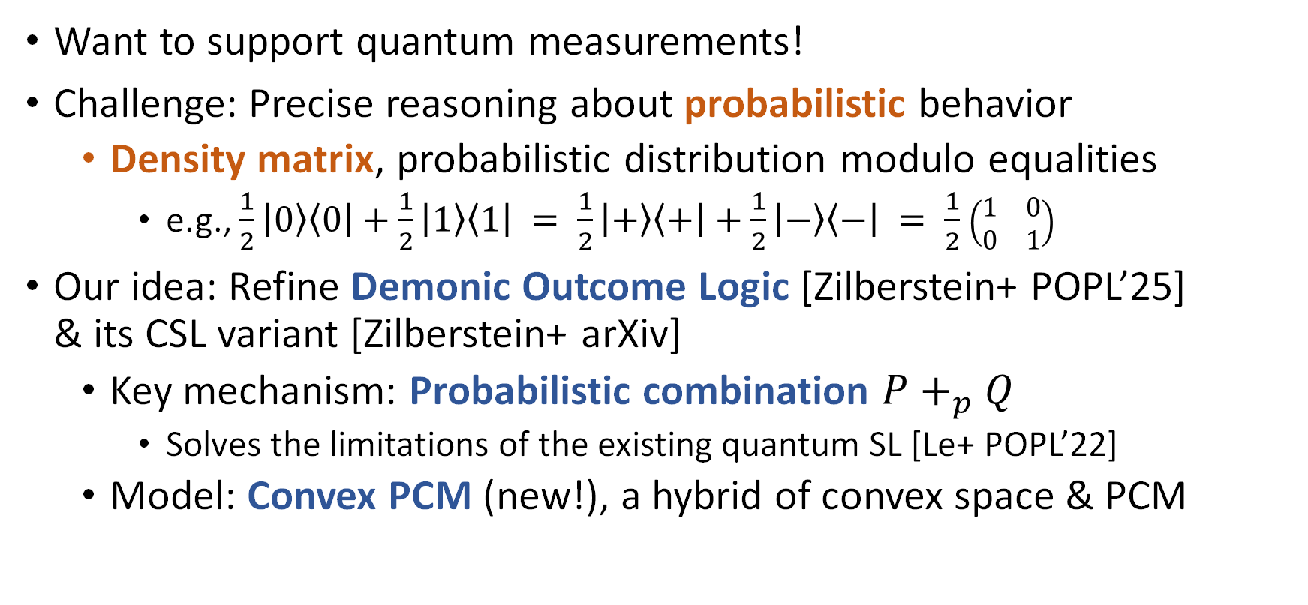
Extension to Probabilistic Reasoning
Want to support quantum measurements!
Challenge: Precise reasoning about probabilistic behavior
  Density matrix, probabilistic distribution modulo equalities
    e.g., $\frac{1}{2}\left|0\right\rangle \left\langle 0\right|+\frac{1}{2}\left|1\right\rangle \left\langle 1\right| = \frac{1}{2}\left|+\right\rangle \left\langle +\right|+\frac{1}{2}\left|−\right\rangle \left\langle −\right| = \frac{1}{2}$ $\left(\begin{matrix}1 & 0 \\ 0 & 1\end{matrix}\right)$
Our idea: Refine Demonic Outcome Logic [Zilberstein+ POPL’25]
& its CSL variant [Zilberstein+ arXiv]
  Key mechanism: Probabilistic combination $P+_{p}Q$
    Solves the limitations of the existing quantum SL [Le+ POPL’22]
  Model: Convex PCM (new!), a hybrid of convex space & PCM
Notes:
We want to support quantum measurements. The primary challenge for that is to precisely reason about probabilistic behavior.
In quantum computing, the standard model for that is a density matrix, which is roughly a probabilistic distribution of state vectors modulo some equalities.
Our idea is to refine the approach of Demonic Outcome Logic, the work published in this POPL and lead-authored by Noam Zilberstein, an organizer of this TPSA.
We are also based on a concurrent separation logic variant of that work.
A key mechanism is the probabilistic combination of logic assertions. This solves the limitations of the existing quantum separation logic.
For the model, we introduce a new mathematic structure called convex PCM, a hybrid of convex space and partial commutative monoid.

Slide 23
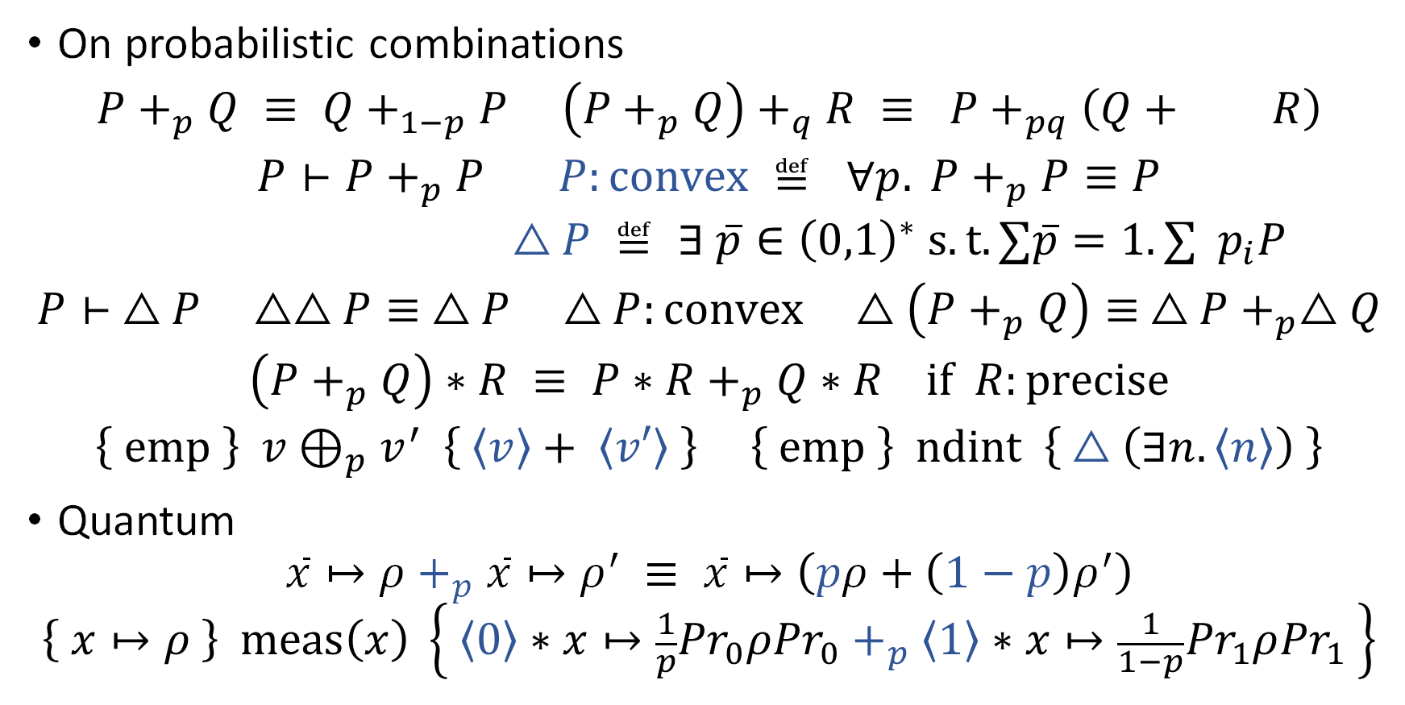
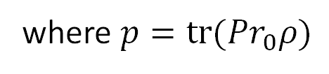



Teaser of Our Probabilistic Quantum SL
On probabilistic combinations
$$P+_{p}Q ≡ Q+_{1−p}P \left(P+_{p}Q\right)+_{q}R ≡ P+_{pq}\left(Q+ R\right)$$
$$P⊢P+_{p}P P:convex ≝ ∀p. P+_{p}P≡P$$
$$△P ≝ ∃ \overline{p}∈{\left(0,1\right)}^{∗} s.t. ∑\overline{p}=1. ∑{ p}_{i}P$$
$$P⊢ △P △△P≡ △P △P:convex △\left(P+_{p}Q\right)≡ △P+_{p}△Q$$
$$\left(P+_{p}Q\right)∗R ≡ P∗R+_{p}Q∗R if R:precise$$
$$\left\{ emp \right\} v⊕_{p}v^{′} \left\{ \left\langle v\right\rangle + \left\langle v′\right\rangle \right\} \left\{ emp \right\} ndint \left\{ △\left(∃n.\left\langle n\right\rangle \right) \right\}$$
Quantum
$$\overline{x}↦ρ+_{p}\overline{x}↦ρ^{′} ≡ \overline{x}↦\left(pρ+\left(1−p\right)ρ^{′}\right)$$
$$\left\{ x↦ρ \right\} meas\left(x\right) \left\{ \left\langle 0\right\rangle ∗x↦\frac{1}{p}{Pr}_{0}ρ{Pr}_{0}+_{p}\left\langle 1\right\rangle ∗x↦\frac{1}{1−p}{Pr}_{1}ρ{Pr}_{1} \right\}$$
$$\frac{\left(1−p\right)q}{1−pq}$$
Convex hull modality
$$i$$
$$p$$
where $p=tr({Pr}_{0}ρ)$
Notes:
Here is the teaser of our probabilistic quantum separation logic.
Unlike demonic outcome logic, we introduce the concept of convex assertions with the convex hull modality, related to the idempotence of the probabilistic combination.
Also, we manage return values as resources in separation logic to model probabilistically varying return values.
On the quantum side, we make the points-to token assert a density matrix instead of a vector, following the probabilistic combination, and naturally support measurement.

Slide 24
Conclusion
We proposed a concurrent quantum separation logic
for modular verification of fine-grained parallelism
Our logic supports shared quantum resources via invariants,
the linear combination rule, and the anti-frame rule by atomicity
Future work
  More powerful concurrency reasoning
  Automated optimization of quantum programs & its verification
Notes:
Finally, this is the conclusion of our talk.
For future directions, we are interested in more powerful concurrency reasoning and automated optimization of quantum programs.
That’s all. Thank you for listening!
(~2min30)

Slide 25
References
Zhou, Li, Gilles Barthe, Justin Hsu, Mingsheng Ying, and Nengkun Yu. “A Quantum Interpretation of Bunched Logic for Quantum Separation Logic.” arXiv:2102.00329 [Quant-Ph], January 30, 2021. http://arxiv.org/abs/2102.00329.
Le, Xuan-Bach, Shang-Wei Lin, Jun Sun, and David Sanan. “A Quantum Interpretation of Separating Conjunction for Local Reasoning of Quantum Programs Based on Separation Logic.” Proceedings of the ACM on Programming Languages 6, no. POPL (11 2022): 36:1-36:27. https://doi.org/10.1145/3498697.
Su, Bonan, Li Zhou, Yuan Feng, and Mingsheng Ying. “BI-Based Reasoning about Quantum Programs with Heap Manipulations.” arXiv, September 16, 2024. https://doi.org/10.48550/arXiv.2409.10153.
Zilberstein, Noam, Angelina Saliling, and Alexandra Silva. “Outcome Separation Logic: Local Reasoning for Correctness and Incorrectness with Computational Effects.” Proc. ACM Program. Lang. 8, no. OOPSLA1 (29 2024): 104:276-104:304. https://doi.org/10.1145/3649821.
Svyatlovskiy, Mikhail, Shai Mermelstein, and Ori Lahav. “Compositional Semantics for Shared-Variable Concurrency.” Coq Mechanization for “Compositional Semantics for Shared-Variable Concurrency” (PLDI 2024) 8, no. PLDI (20 2024): 169:543-169:566. https://doi.org/10.1145/3656399.
Brookes, Stephen. “Full Abstraction for a Shared-Variable Parallel Language.” Information and Computation 127, no. 2 (June 15, 1996): 145–63. https://doi.org/10.1006/inco.1996.0056.
Ying, Mingsheng, Li Zhou, Yangjia Li, and Yuan Feng. “A Proof System for Disjoint Parallel Quantum Programs.” Theoretical Computer Science 897 (January 2, 2022): 164–84. https://doi.org/10.1016/j.tcs.2021.10.025.

